Slide 1
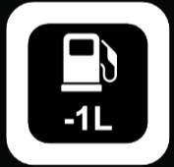

Primary Dash Template / Zones
MESSAGES
FUEL DELTA
0.3
LEFT BAR
RIGHT BAR
DATA ROW 1
DATA ROW 2

Slide 2

On Track Quick Look
PIT WINDOW OPEN L12 – L20
Refuel 30l + Tyres + Repair
EXIT POS
P12
FUEL DELTA
0.3
STOPS REM
2
FUEL BURN LADDER
SAVE
2.3
FUEL CONF
70%
PUSH
-0.5
TYRE
DRY
NEXT STOP
3.0s
REPAIR
YES

Slide 3
Initial Pit Road Entry
LIMITER OFF
+40
FUEL DELTA
0.3
120
SAVE
2.3
FUEL CONF
70%
PUSH
-0.5
80
EXIT POS
P12
GAP P13
6.5s
STOPS REM
2
MAX 80

Slide 4
Initial Pit Road Entry
LIMITER ON
FUEL DELTA
0.3
59
SAVE
2.3
FUEL CONF
70%
PUSH
-0.5
60
EXIT POS
P12
GAP P13
6.5s
STOPS REM
2
MAX 60

Slide 5

Approaching Box (Past Pit Entry Line)
LIMITER ON
FUEL DELTA
0.3
SAVE
2.3
FUEL CONF
70%
PUSH
-0.5
TYRE
DRY
STOP TIME
0s
REPAIR
YES

Slide 6
In Box
LIMITER ON
FUEL DELTA
0.3
OPPONENT LADDER
SAVE
2.3
FUEL CONF
70%
PUSH
-0.5
TYRE
DRY
STOP TIME
3.0s
REPAIR
YES

Slide 7
In Box Messages
IGNITION OFF
ENGINE OFF
SELECT 1st GEAR
TURN ON LIMITER
GO GO GO
LIMITER ON

Slide 8
Exiting Box
LIMITER ON
FUEL DELTA
0.3
OPPONENT LADDER
SAVE
2.3
FUEL CONF
70%
PUSH
-0.5
EXIT POS
P12
GAP P13
6.5s
STOPS REM
2

Slide 9
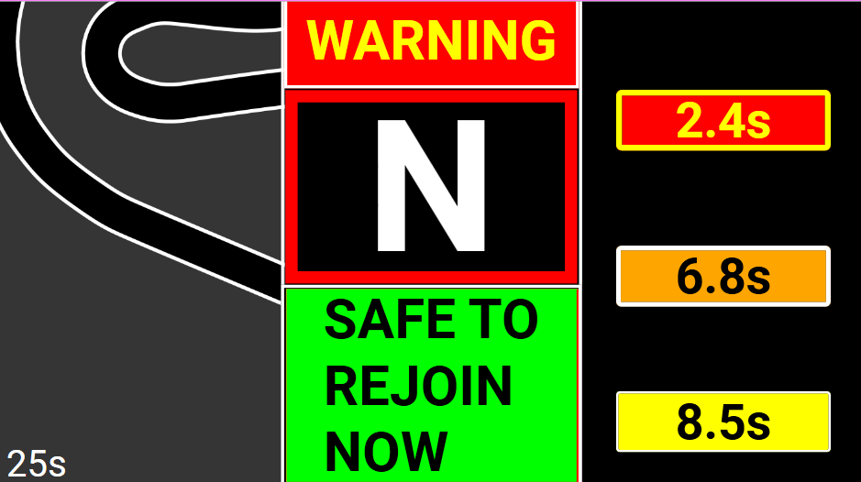
Exiting Pits (With Rejoin Widget-already designed and implemented)
TURN OFF LIMITER
FUEL BURN LADDER
REJOIN DISPLAY

Slide 10
On Track Messages
PIT WINDOW CLOSED
TANK SPACE -6l
PIT WINDOW OPEN L12 – L20
30l + DRY + Repair = 26s
MUST FUEL SAVE
TARGET 3.25
CLEAR PUSH
TARGET 3.41 / UNRESTRICTED

Slide 11
On Track Messages
BOX SOON
2 LAPS IN TANK
BOX BOX BOX
TURN OFF LIMITER
PIT LANE CLOSED

Slide 12
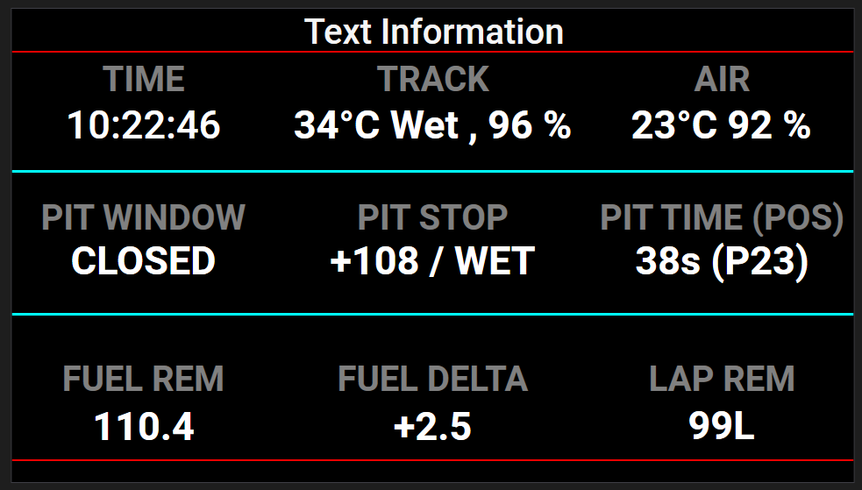
Message Dash Main Page – Each Row can be pressed to enter extra pages as below

Slide 13
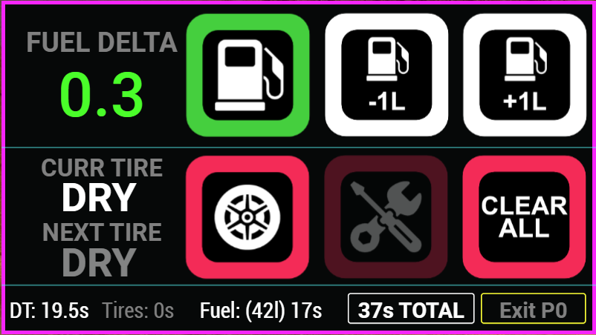
Message Dash - On Track Pit Page
42
CURRENT
NEXT
DT: 17s TYRES: 22s FUEL: 18s
57s Loss

Slide 14


Message Dash - On Track Fuel Page
PIT WINDOW OPEN L12 – L20
Refuel 30l + Tyres + Repair
MFD SET
12
NEED NEXT
10
FUEL CONF
75%
FUEL BURN LADDER
SAVE
2.3
FUEL DELTA
0.5
PUSH
-0.5
AUTO
ZERO

Slide 15
Message Dash Main Page – Each Row can be pressed to enter extra pages as below

Slide 16
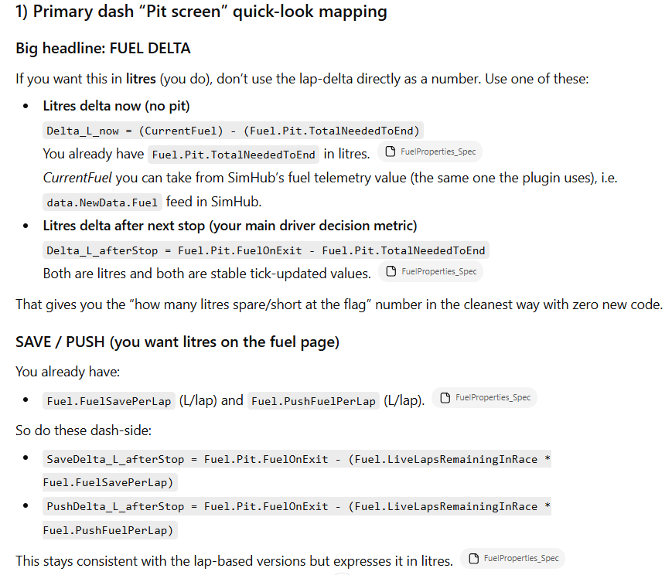
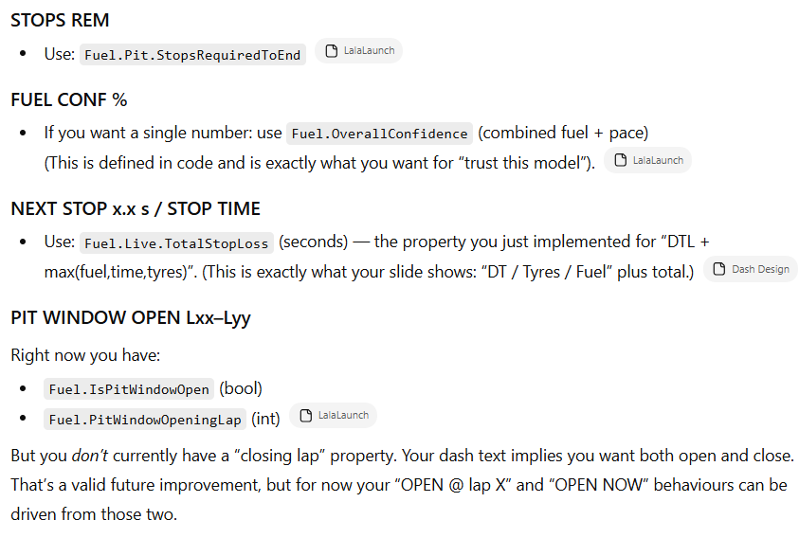

Slide 17
